Slide 1
Sorting
Chapter 9

Slide 2
Objectives
Elementary Sorting Algorithms
Selection Sort
Insertion Sort
Bubble Sort
Efficient Sorting Algorithms
Shell sort
Quick Sort
Merge Sort
Heap sort
Radix Sort (*)
Sorting in java.util
Reading at home
Notes:
Note: (*) Means that students are required to understand essential features only (the problem explanation, definitions, the outline of algorithms…), not in details.

Slide 3
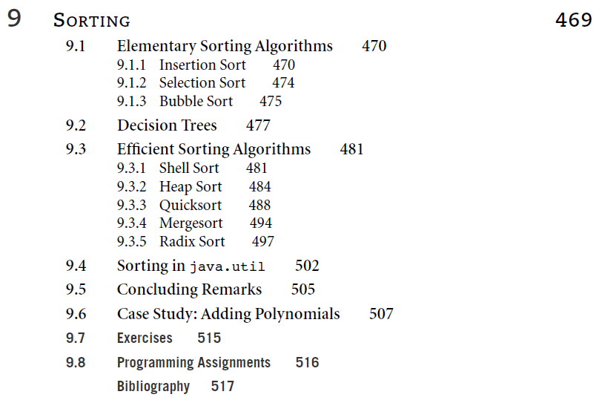

Slide 4
Java

Slide 5
Examples
Simple keys: string, number
Up (A->Z) and down (Z->A)
Compound keys: name then age, gender then salary
Up and down with compound keys

Slide 6
Java Sorted Structures
Tree Set
Tree Map

Slide 7
Sorting in java.util
Java provides two sets of versions for sorting methods: one for arrays and one for lists
The utility class Arrays includes method for
Search for elements with binary search
Filling arrays with a particular value
Converting array into a list
And sorting method
The sorting methods are provided for arrays with elements of all elementary types except boolean
For each type of sorting method there are two versions
One for sorting an entire array
public static void sort(int[] a)
One for sorting a subarray
public static void sort(int[] a, int first, int last)

Slide 8
Selection sort
Find the smallest item in the unsorted array
Append it to the sorted array

Slide 9
Selection sort
An attempt to localize the exchanges of array elements by finding a misplaced element first and putting it in its final place
Its complexity is O(n²)
selectionsort(data[])
for i=0 to data.length-2
select the smallest (or largest) element data[k] among data[i],…, data[data.length-1];
swap data[i] with data[k];

Slide 10
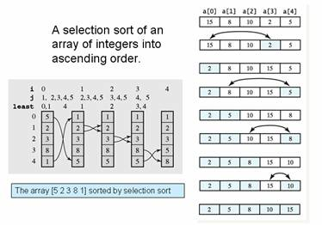
Selection example

Slide 11
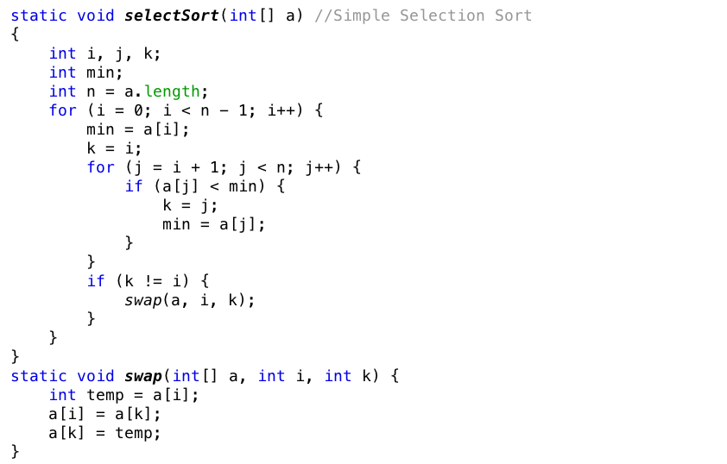
Selection sort implementation

Slide 12
Insertion sort algorithm
Take q from the unsorted array
Insert q into the right place of the sorted array

Slide 13
Insertion Sort
23
17
45
18
12
22

Slide 14
Insertion Sort
23
17
45
18
12
22
1
2
3
4
5
6

Slide 15
Insertion Sort
23
17
45
18
12
22
1
2
3
4
5
6
1
2
3
4
5
6

Slide 16
Insertion Sort
17
45
18
12
22
1
2
3
4
5
6
23
1
2
3
4
5
6

Slide 17
Insertion Sort
45
18
12
22
1
2
3
4
5
6
17
23
1
2
3
4
5
6

Slide 18
Insertion Sort
18
12
22
1
2
3
4
5
6
17
23
45
1
2
3
4
5
6

Slide 19
Insertion Sort
12
22
1
2
3
4
5
6
17
18
23
45
1
2
3
4
5
6

Slide 20
Insertion Sort
1
2
3
4
5
6
12
17
18
22
23
45
1
2
3
4
5
6

Slide 21
Insertion sort
An insertion sort starts by considering the two first elements of the array data, which are data[0] and data[1]
Next, the third element, data[2], is considered and inserted into its proper place (ascending)
Its complexity is O(n2) and best case is O(n)
insertionsort(data[])
for i=0 to data.length-1
tmp=data[i];
move all elements data[j] greater than tmp by one position;
place tmp in its proper position;

Slide 22
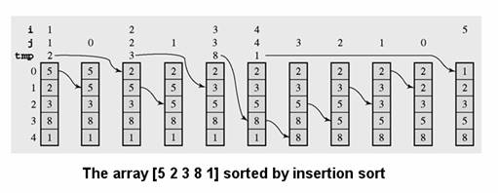
Insertion sort example

Slide 23
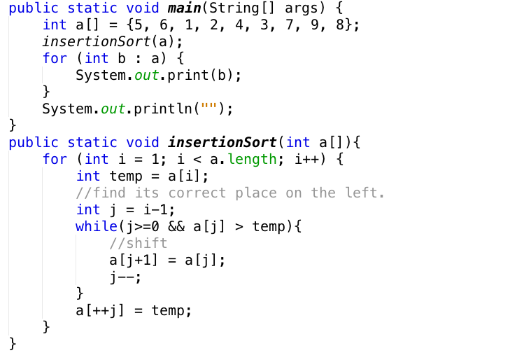
Insertion sort

Slide 24
Bubble Sort
Swapping the two adjacent elements if needed
Repeat the process until nothing can be swap

Slide 25
Bubble Sort
Value present in each element is compared with subsequent elements to get the smallest/largest value
There are 2 approaches in bubble sort implementation:
Bottom-up
Top-down
Complexity O(n²); Best case O(n)

Slide 26
Bubble Sort
j=i+1=1
i=0
a[i]
a[j]
5
4
3
7
1
For an array of n elements
Repeat these following steps n-1 times:
With a[i] and a[j]:
If a[i] greater than a[j] then swap their location.

Slide 27
Bubble Sort
j=2
i=0
a[i]
a[j]
4
5
3
7
1
For an array of n elements
Repeat these following steps n-1 times:
With a[i] and a[j]:
If a[i] greater than a[j] then swap their location.

Slide 28
Bubble Sort
j=3
i=0
a[i]
No bubbling
a[j]
3
5
4
7
1
For an array of n elements
Repeat these following steps n-1 times:
With a[i] and a[j]:
If a[i] greater than a[j] then swap their location.

Slide 29
Bubble Sort
j=4
i=0
a[i]
a[j]
3
5
4
7
1
So after first i (=0) and a complete loop of j (from i+1 to length-1)
The smallest element is bubbled to the first place (place of i=0)
For an array of n elements
Repeat these following steps n-1 times:
With a[i] and a[j]:
If a[i] greater than a[j] then swap their location.

Slide 30
Bubble Sort
j=i+1=2
i=1
a[i]
a[j]
1
5
4
7
3
For an array of n elements
Repeat these following steps n-1 times:
With a[i] and a[j]:
If a[i] greater than a[j] then swap their location.

Slide 31
Bubble Sort
No bubbling
j=i+1=3
i=1
a[i]
a[j]
1
4
5
7
3
For an array of n elements
Repeat these following steps n-1 times:
With a[i] and a[j]:
If a[i] greater than a[j] then swap their location.

Slide 32
Bubble Sort
j=i+1=4
i=1
a[i]
a[j]
1
4
5
7
3
Similarly, after second i (=1) and a complete loop of j (from i+1 to length-1)
The second smallest is bubbled to the second place (place of i=1)…
So on and so forth, so all the values will be bubbled to the first of the list
For an array of n elements
Repeat these following steps n-1 times:
With a[i] and a[j]:
If a[i] greater than a[j] then swap their location.

Slide 33
Bubble Sort
int i,j,temp,arr[5]={23,90,9,25,16};
for (int i=0; i<4; i++)
{
for (int j=i+1; j<5; j++)
{
if (arr[i] > arr[j])
{
int temp = arr[j];
arr[j] = arr[i];
arr[i] = temp;
}
}
}

Slide 34
Efficient Sorting Algorithms
Shell Sort, Quick Sort, Merge sort, Heap sort, Radix sort

Slide 35
Merge sort
n*logn

Slide 36
Mergesort
Mergesort makes partitioning as simple as possible and concentrates on merging sorted halves of an array into one sorted array
Complexity is O(nlogn)
It was one of the first sorting algorithms used on a computer and was developed by John von Neumann
mergesort(data)
if data have at least two elements
mergesort(lefthalf of data);
mergesort(righthalf of data);
merge(both halves into a sorted list);

Slide 37
Mergesort algorithm
mergesort(data)
if data have at least two elements
mergesort(lefthalf of data);
mergesort(righthalf of data);
merge(both halves into a sorted list);
merge (array1, array2, array3)
i1, i2, i3 are properly initialized;
while both array2 and array3 contain elements;
if array2[i2]<array3[i3]
array1[i1++]=array2[i2++]
else
array1[i1++]=array2[i3++]
load into array1 the remaining elements of either array2 or array3

Slide 38
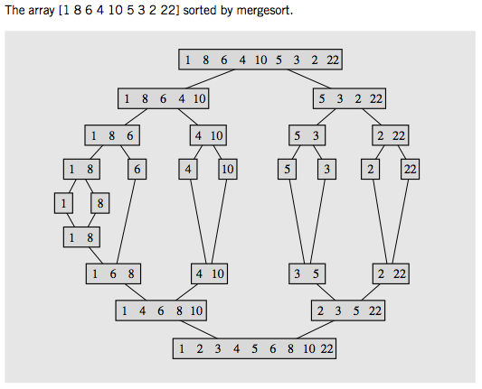
Mergesort example

Slide 39
Quick sort

Slide 40
Quick sort
Efficient algorithm, discovered by C.A.R Hoare
Example of divide and conquer algorithm
Two phases
Partition phase
Divide the work into half
Sort phase
Conquer the halves

Slide 41


Partition & conquer
Choose a pivot
Find the position for the pivot so that
All elements to the left are less
All elements to the right are greater
Conquer
Apply the same algorithm to each halves

Slide 42
Quick sort complexity
In the best case and average case O(n log n)
Can be O(n2)
Depends on pivot selection
Median-of-3
Random pivot
Better but no guarantee

Slide 43
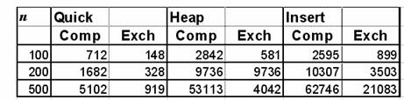
Quicksort – Why bother?
Use Heapsort instead?
Quicksort is generally faster
Fewer comparisons and exchanges
Some empirical data

Slide 44
How to partition
Define the pivot value as the contents of Table[First]
Initialize Up to First and Down to Last
Repeat
Increment Up until Up selects the first element > the pivot value
Decrement Down until it selects the first element <= the pivot value
If Up<Down exchange their values until Up meets or passes Down
Exchange Table[First] and Table[Down]
Define PivIndex as Down

Slide 45
Partition
First
Last
5
3
2
4
8
8
7
9
1
1
6
Up
Up
Up
Up
Up
Down
Down
Pivot value = a[First] = 5
Pivot index = ?
Increase Up to the first index with value > Pivot value
Decrease Down to the first index with value <= Pivot value
Up < Down => Swap their values

Slide 46
Partition
First
Last
5
3
2
4
1
1
7
7
9
8
6
Up
Up
Down
Down
Down
Down
Pivot value = a[First] = 5
Pivot index = ?
Increase Up to the first index with value > Pivot value
Decrease Down to the first index with value <= Pivot value
Up < Down => Swap their values
Down < Up => Swap values of First and Down & Pivot index = down

Slide 47
Partition
First
Last
5
3
2
4
1
7
7
9
8
6
Up
Down
Pivot value = a[First] = 5
Pivot index = ?
Increase Up to the first index with value > Pivot value
Decrease Down to the first index with value <= Pivot value
Up < Down => Swap their values
Down < Up => Swap values of First and Down & Pivot index = down

Slide 48
Partition
First
Last
1
3
2
4
5
5
7
9
8
6
Done
So on and so forth… left then right
Pivot value = a[First] = 5
Pivot index = ?
Increase Up to the first index with value > Pivot value
Decrease Down to the first index with value <= Pivot value
Up < Down => Swap their values
Down < Up => Swap values of First and Down & Pivot index = down

Slide 49
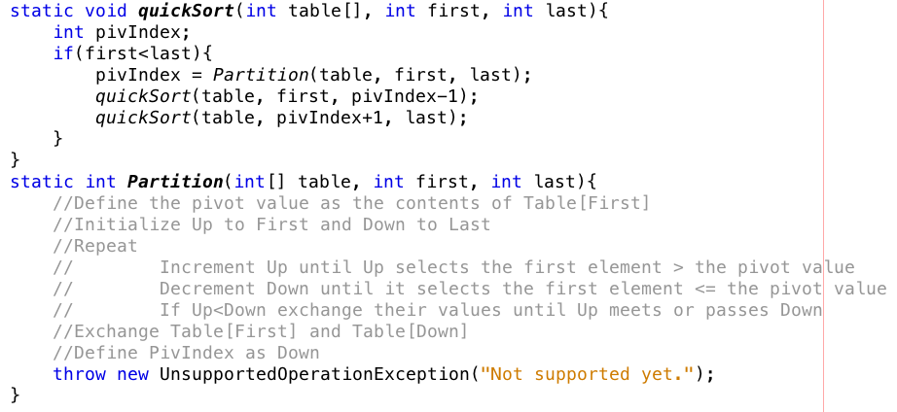
How do we partition

Slide 50
Shell sort

Slide 51
Shell sort
Shell sort is a sorting algorithm that is a generalization of insertion sort, with two observations
Insertion sort is efficient if the input is “almost sorted”
Insertion sort is typically inefficient because it moves values just one position at a time.
Shell sort improvements
Comparing elements separated by a gap of several positions
This lets an element take “bigger steps” toward its expected position.
Multiple passes over the data are taken with smaller and smaller gap sizes.
The last step of Shell sort is a plain insertion sort, but by then, the array of data is guaranteed to be almost sorted.
Complexity is about O(n1.5); Best case O(n)

Slide 52
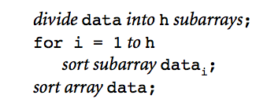
Shell sort
It is more efficient to sort parts of the original array first
If they are at least partially ordered, to sort the entire array.
If the subarrays are already sorted, we are that much closer to the best case of an ordered array than initially.
A general outline of such a procedure is as follows:

Slide 53
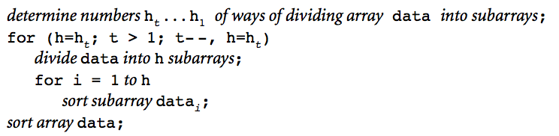
Selecting number of subarrays
If h is too small, then the subarrays data_{i} of array data could be too large then the algorithm is inefficient
If h is too large, then too many small subarrays, it does not substantially change the overall order of data.
So, several different subdivisions are used and for every subdivision, the same procedure is applied separately.

Slide 54
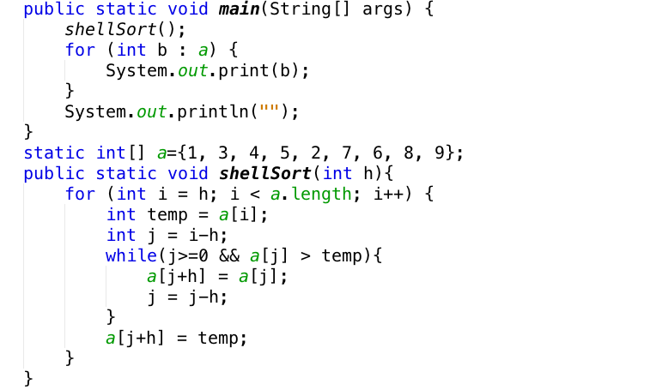
Shell sort implementation

Slide 55
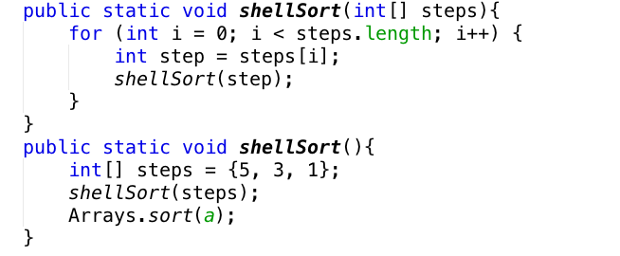
Shell sort implementation

Slide 56
Radix sort

Slide 57
Radix sort
Radix sort is a clever and intuitive little sorting algorithm.
Radix Sort puts elements in order by comparing the digits of the numbers.
We will explain with an example
Consider the following numbers:
493, 812, 715, 710, 195, 437, 582, 340, 385

Slide 58
Step 1: the one’s digit
493, 812, 715, 710, 195, 437, 582, 340, 385 (this is input order)
We should start sorting by comparing and ordering the one’s digits:
Now, we gather the sublists (in order from the 0 sublist to the 9 sublist)
Digit | sublist
0 | 710, 340
1
2 | 812, 582
3 | 493
4
5 | 715, 195, 385
6
7 | 437
8
9

Slide 59
Step 2: the ten’s digit
710, 340, 812, 582, 493, 715, 195, 385, 437 (gathered from previous step = ordered by one’s digit)
We should now sort by comparing and ordering the ten’s digits:
Now, we gather the sublists (in order from the 0 sublist to the 9 sublist)
Digit | sublist
0
1 | 710, 812, 715
2
3 | 437
4 | 340
5
6
7
8 | 582, 385
9 | 493, 195

Slide 60
Step 3: the hundred’s digit
710, 812, 715, 437, 340, 582, 385, 493, 195 (gathered from previous step)
The sublists are created according to the hundred's digit
Digit | sublist
0
1 | 195
2
3 | 340, 385
4 | 437, 493
5 | 582
6
7 | 710, 715
8 | 812
9

Slide 61
Final step: gather the final data
Gather data from the last list we have:
195, 340, 385, 437, 493, 582, 710, 715, 812
It’s ordered by hundred’s digits, then ten’s digit, then one’s digit. Or it’s ordered.
Radix Sort is very simple, and a computer can do it fast.
When it is programmed properly, Radix Sort is in fact one of the fastest sorting algorithms for numbers or strings of letters.

Slide 62
Disadvantages
Still, there are some tradeoffs for Radix Sort that can make it less preferable than other sorts.
The speed of Radix Sort largely depends on the inner basic operations
If the operations are not efficient enough, Radix Sort can be slower than some other algorithms such as Quick Sort and Merge Sort.
These operations include
insert and delete functions of the sublists and
process of isolating the digit you want.

Slide 63
Henry: observations
Group 1xy together, 2xy together
Now inside 1xy, group 11y together, and 12y together
We need padding
The complexity of O(n*d)
Like building the tree from top

Slide 64
Summaries
Elementary Sorting Algorithms
Selection Sort
Insertion Sort
Bubble Sort
Efficient Sorting Algorithms
Shell sort
Quick Sort
Merge Sort
Heap sort
Radix Sort (*)
Sorting in java.util
Reading at home
Notes:
Note: (*) Means that students are required to understand essential features only (the problem explanation, definitions, the outline of algorithms…), not in details.

